Slide 1
Reinforcement Learning
AICTE-MARGDARSHAN sponsored workshop on Computational Intelligence for Multimedia
T. T. Mirnalinee
T. T. Mirnalinee
Prof/CSE
SSN College of Engineering
mirnalineett@ssn.edu.in
Fei-Fei Li & Justin Johnson & Serena Yeung Lecture 14 1 May 23, 2017

Slide 2
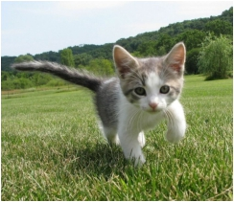
Supervised Learning
Data: (x, y)
x is data, y is label
Goal: Learn a function to map x -> y
Examples: Classification, regression, object detection,
Cat
semantic segmentation, image captioning, etc.
Classification
Fei-Fei Li & Justin Johnson & Serena Yeung Lecture 14 - 5 May 23, 2017

Slide 3
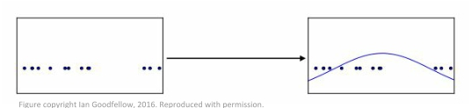
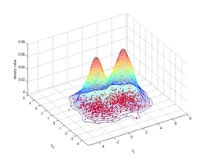
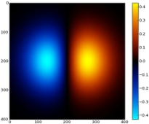
Unsupervised Learning
Data: x
Just data, no labels!
Goal: Learn some underlying hidden structure of the data
Examples: Clustering, dimensionality reduction, feature learning, density estimation, etc.
Fei-Fei Li & Justin Johnson & Serena Yeung Lecture 14 - 6 May 23, 2017

Slide 4
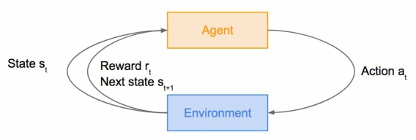
Reinforcement Learning
Problems involving an agent interacting with an environment, which provides numeric reward signals
Goal: Learn how to take actions in order to maximize reward
At each step t the agent:
Executes action At
Receives observation Ot
Receives scalar reward Rt
The environment:
Receives action At
Emits observation Ot+1
Emits scalar reward Rt+1
Fei-Fei Li & Justin Johnson & Lecture 14 - 7 May 23, 2017

Slide 5
Learning from interaction with an environment to achieve some long-term goal that is related to the state of the environment
The goal is defined by reward signal, which must be maximised
Agent must be able to partially/fully sense the environment state and take actions to influence the environment state
The state is typically described with a feature-vector

Slide 6
Terminologies
A reward R_{t} is a scalar feedback signal
Indicates how well agent is doing at step t
The agent's job is to maximise cumulative reward
Policy: agent's behaviour function
Value function: how good is each state and/or action
Model: agent's representation of the environment

Slide 7
Policy
A policy is the agent's behaviour
It is a map from state to action
Deterministic policy
Stochastic policy

Slide 8
Value function
Value function is a prediction of future reward
Used to evaluate the goodness/badness of states
And therefore to select between actions

Slide 9
Model
A model predicts what the environment will do next
P - predicts the next state
R- predicts the next (immediate) reward

Slide 10
Agent
Value based
Policy based
Exploration finds more information about the environment
Exploitation exploits known information to maximise reward
It is usually important to explore as well as exploit

Slide 11
Agents algorithm
Repeat:
s ← sensed state
If s is terminal then exit
a ← Π(s)
Perform a

Slide 12
Types of Reinforcement learning
Search-based: evolution directly on a policy
E.g. optimization algorithm –GA, PSO
Model-based: build a model of the environment
Then you can use dynamic programming
Memory-intensive learning method
Model-free: learn a policy without any model
Temporal difference methods (TD)
Requires limited episodic memory (though more helps)

Slide 13
Reinforcement Learning
Agent
Environment
Fei-Fei Li & Justin Johnson & Serena Yeung Lecture 14 9 May 23, 2017

Slide 14
Reinforcement Learning
Agent
State st
Environment
Fei-Fei Li & Justin Johnson & Serena Yeung Lecture 14 10 May 23, 2017

Slide 15
Reinforcement Learning
Agent
State st Action at
Environment
Fei-Fei Li & Justin Johnson & Serena Yeung Lecture 14 11 May 23, 2017

Slide 16
Reinforcement Learning
Agent
State st Reward rt Action at
Environment
Fei-Fei Li & Justin Johnson & Serena Yeung Lecture 14 12 May 23, 2017

Slide 17
Reinforcement Learning
Agent
State st
Reward rt Next state st+1
Action at
Environment
Fei-Fei Li & Justin Johnson & Serena Yeung Lecture 14 13 May 23, 2017

Slide 18
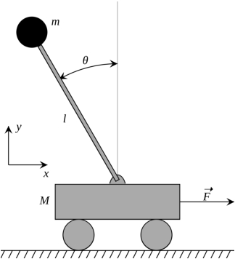
Cart-Pole Problem
Objective: Balance a pole on top of a movable cart
State: angle, angular speed, position, horizontal velocity Action: horizontal force applied on the cart
Reward: 1 at each time step if the pole is upright
Fei-Fei Li & Justin Johnson & Serena Yeung Lecture 14 - 14 May 23, 2017

Slide 19
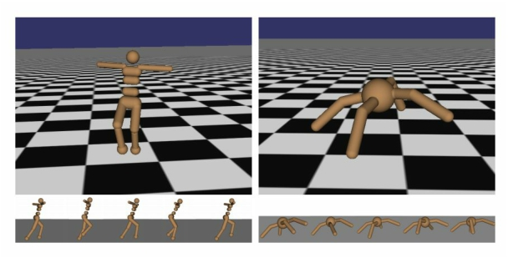
Robot Locomotion
Objective: Make the robot move forward
State: Angle and position of the joints Action: Torques applied on joints Reward: 1 at each time step upright + forward movement
Fei-Fei Li & Justin Johnson & Lecture 14 - 15 May 23, 2017

Slide 20

Markov Decision Process
- Mathematical formulation of the RL problem
- Markov property: Current state completely characterises the state of the
world
Defined by:
: set of possible states
: set of possible actions
: distribution of reward given (state, action) pair
: transition probability i.e. distribution over next state given (state, action) pair : discount factor
Fei-Fei Li & Justin Johnson & Serena Yeung Lecture 14 - 19 May 23, 2017

Slide 21

Markov Decision Process
- At time step t=0, environment samples initial state s0 ~ p(s0) - Then, for t=0 until done:
- Agent selects action at
- Environment samples reward rt ~ R( . | st, at)
- Environment samples next state st+1 ~ P( . | st, at) - Agent receives reward rt and next state st+1
- A policy is a function from S to A that specifies what action to take in
each state
- Objective: find policy * that maximizes cumulative discounted reward:
Fei-Fei Li & Justin Johnson & Serena Yeung Lecture 14 - 20 May 23, 2017

Slide 22
A simple MDP: Grid World
states
actions = {
1. right
★
 |  |  | ★
2. left
3. up
4. down
Set a negative “reward”
for each transition
(e.g. r = -1)
}
Objective: reach one of terminal states (greyed out) in
least number of actions
Fei-Fei Li & Justin Johnson & Serena Yeung Lecture 14 - 21 May 23, 2017

Slide 23
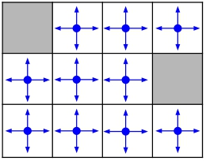
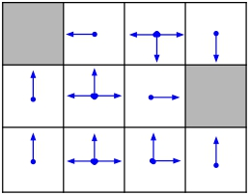
A simple MDP: Grid World
★ ★
★ ★
Random Policy Optimal Policy
Fei-Fei Li & Justin Johnson & Serena Yeung Lecture 14 - 22 May 23, 2017

Slide 24
The optimal policy *
We want to find optimal policy * that maximizes the sum of rewards. How do we handle the randomness (initial state, transition probability…)?
Fei-Fei Li & Justin Johnson & Serena Yeung Lecture 14 - 23 May 23, 2017

Slide 25
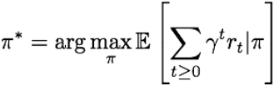
The optimal policy *
We want to find optimal policy * that maximizes the sum of rewards.
How do we handle the randomness (initial state, transition probability…)? Maximize the expected sum of rewards!
Formally: with
Fei-Fei Li & Justin Johnson & Serena Yeung Lecture 14 - 24 May 23, 2017

Slide 26
Definitions: Value function and Q-value function
Following a policy produces sample trajectories (or paths) s0, a0, r0, s1, a1, r1, …
Fei-Fei Li & Justin Johnson & Serena Yeung Lecture 14 - 25 May 23, 2017

Slide 27

Definitions: Value function and Q-value function
Following a policy produces sample trajectories (or paths) s0, a0, r0, s1, a1, r1, …
How good is a state?
The value function at state s, is the expected cumulative reward from following the policy from state s:
Fei-Fei Li & Justin Johnson & Serena Yeung Lecture 14 - 26 May 23, 2017

Slide 28

Definitions: Value function and Q-value function
Following a policy produces sample trajectories (or paths) s0, a0, r0, s1, a1, r1, …
How good is a state?
The value function at state s, is the expected cumulative reward from following the policy from state s:
How good is a state-action pair?
The Q-value function at state s and action a, is the expected cumulative reward from taking action a in state s and then following the policy:
Fei-Fei Li & Justin Johnson & Serena Yeung Lecture 14 - 27 May 23, 2017

Slide 29
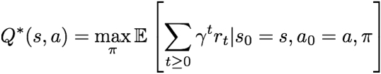
Bellman equation
The optimal Q-value function Q* is the maximum expected cumulative reward achievable from a given (state, action) pair:
Fei-Fei Li & Justin Johnson & Serena Yeung Lecture 14 - 28 May 23, 2017

Slide 30


Bellman equation
The optimal Q-value function Q* is the maximum expected cumulative reward achievable from a given (state, action) pair:
Q* satisfies the following Bellman equation:
if the optimal state-action values for the next time-step Q*(s’,a’) are known, then the optimal strategy is to take the action that maximizes the expected value of
Fei-Fei Li & Justin Johnson & Serena Yeung Lecture 14 - 29 May 23, 2017

Slide 31
Bellman equation
The optimal Q-value function Q* is the maximum expected cumulative reward achievable from a given (state, action) pair:
Q* satisfies the following Bellman equation:
if the optimal state-action values for the next time-step Q*(s’,a’) are known, then the optimal strategy is to take the action that maximizes the expected value of
The optimal policy * corresponds to taking the best action in any state as specified by Q*
Fei-Fei Li & Justin Johnson & Serena Yeung Lecture 14 - 30 May 23, 2017

Slide 32

Solving for the optimal policy
Value iteration algorithm: Use Bellman equation as an iterative update
Qi will converge to Q* as i -> infinity
Fei-Fei Li & Justin Johnson & Serena Yeung Lecture 14 - 31 May 23, 2017

Slide 33
Solving for the optimal policy
Value iteration algorithm: Use Bellman equation as an iterative update
Qi will converge to Q* as i -> infinity
What’s the problem with this?
Fei-Fei Li & Justin Johnson & Serena Yeung Lecture 14 - 32 May 23, 2017

Slide 34
Solving for the optimal policy
Value iteration algorithm: Use Bellman equation as an iterative update
Qi will converge to Q* as i -> infinity
What’s the problem with this?
Not scalable. Must compute Q(s,a) for every state-action pair. If state is e.g. current game state pixels, computationally infeasible to compute for entire state space!
Fei-Fei Li & Justin Johnson & Serena Yeung Lecture 14 - 33 May 23, 2017

Slide 35
Solving for the optimal policy
Value iteration algorithm: Use Bellman equation as an iterative update
Qi will converge to Q* as i -> infinity
What’s the problem with this?
Not scalable. Must compute Q(s,a) for every state-action pair. If state is e.g. current game state pixels, computationally infeasible to compute for entire state space!
Solution: use a function approximator to estimate Q(s,a). E.g. a neural network!
Fei-Fei Li & Justin Johnson & Serena Yeung Lecture 14 - 34 May 23, 2017

Slide 36

Solving for the optimal policy: Q-learning
Q-learning: Use a function approximator to estimate the action-value function
Fei-Fei Li & Justin Johnson & Serena Yeung Lecture 14 - 35 May 23, 2017

Slide 37
Solving for the optimal policy: Q-learning
Q-learning: Use a function approximator to estimate the action-value function
If the function approximator is a deep neural network => deep q-learning!
Fei-Fei Li & Justin Johnson & Serena Yeung Lecture 14 - 36 May 23, 2017

Slide 38

Solving for the optimal policy: Q-learning
Q-learning: Use a function approximator to estimate the action-value function
function parameters (weights)
If the function approximator is a deep neural network => deep q-learning!
Fei-Fei Li & Justin Johnson & Serena Yeung Lecture 14 - 37 May 23, 2017

Slide 39

Solving for the optimal policy: Q-learning
Remember: want to find a Q-function that satisfies the Bellman Equation:
Fei-Fei Li & Justin Johnson & Serena Yeung Lecture 14 - 38 May 23, 2017

Slide 40

Solving for the optimal policy: Q-learning
Remember: want to find a Q-function that satisfies the Bellman Equation: Forward Pass
where
Fei-Fei Li & Justin Johnson & Serena Yeung Lecture 14 - 39 May 23, 2017

Slide 41
Solving for the optimal policy: Q-learning
Remember: want to find a Q-function that satisfies the Bellman Equation: Forward Pass
where
Backward Pass
Gradient update (with respect to Q-function parameters θ):
Fei-Fei Li & Justin Johnson & Serena Yeung Lecture 14 - 40 May 23, 2017

Slide 42

Solving for the optimal policy: Q-learning
Remember: want to find a Q-function that satisfies the Bellman Equation:
Forward Pass
Iteratively try to make the Q-value close to the target value (yi) it should have, if Q-function
where
corresponds to optimal Q* (and optimal policy *)
Backward Pass
Gradient update (with respect to Q-function parameters θ):
Fei-Fei Li & Justin Johnson & Serena Yeung Lecture 14 - 41 May 23, 2017

Slide 43
Current state: s
Current action: a
Transition function: δ(s, a) = sʹ
Reward function: r(s, a) Є R
Policy π(s) = a
Q(s, a) ≈ value of taking action a from state s

Slide 44
The Q-function
Q(s, a) estimates the discounted cumulative reward
Starting in state s
Taking action a
Following the current policy thereafter
Suppose we have the optimal Q-function
What’s the optimal policy in state s?
The action argmax_{b} Q(s, b)
But we don’t have the optimal Q-function at first
Let’s act as if we do
And updates it after each step so it’s closer to optimal
Eventually it will be optimal!

Slide 45
Q-Learning: The Procedure
Agent
Q(s₁, a) = 0
π(s₁) = a₁
Q(s₁, a₁) ← Q(s₁, a₁) + Δ
π(s₂) = a₂
a₁
a₂
s₂
s₃
s₁
r₂
r₃
Environment
δ(s₁, a₁) = s₂
r(s₁, a₁) = r₂
δ(s₂, a₂) = s₃
r(s₂, a₂) = r₃

Slide 46
Q-Learning: Updates
The basic update equation
With a discount factor to give later rewards less impact
With a learning rate for non-deterministic worlds

Slide 47
Q-Learning
foreach state s foreach action a Q(s,a)=0 s=currentstate do forever a = select an action do action a r = reward from doing a t = resulting state from doing a Q(s,a) = (1 – α) Q(s,a) + α (r + γ Q(t)) s = t
The learning coefficient, α, determines how quickly our estimates are updated
Normally, α is set to a small positive constant less than 1

Slide 48
What about very large state-spaces?
Value-Based: Learning a model and utility function
Can be difficult to learn good models for large complex environments
(e.g. learning a DBN representation)
But if we can learn a model then learning utility function is simpler than learning Q(s,a)
Also can reuse the model for “related problems”
Q-learning: Learning Q-function
Simpler to implement since we don’t need to worry about representing and learning a model
But Q-functions can be substantially more complex than utility functions (must somehow make up for not having the model)

Slide 49
Exploration versus Exploitation
We want a reinforcement learning agent to earn lots of reward
The agent must prefer past actions that have been found to be effective at producing reward
The agent must exploit what it already knows to obtain reward
The agent must select untested actions to discover reward-producing actions
The agent must explore actions to make better action selections in the future
Trade-off between exploration and exploitation

Slide 50
Exploitation: Maximize its reward
Exploration: Maximize long-term
well being.

Slide 51
Summary
There is no supervisor, only a reward signal
Feedback is delayed, not instantaneous
Time really matters
Agent's actions act the subsequent data it receives

Slide 52
Goal is to learn utility values of states and
an optimal mapping from states to actions.
Direct Utility Estimation ignores
dependencies among states → we must
follow Bellman Equations.
Temporal difference updates values to
match those of successor states.
Active reinforcement learning learns the
optimal mapping from states to actions

